Slide 1
Recommender Systems
Good Advice
Notes:
Recap on last midterm presentation

Slide 2
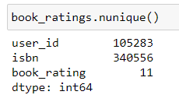
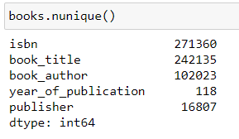
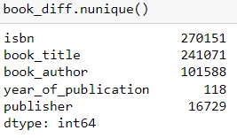
Exploration
Data Wrangling
Unrealistic Publication Dates
Potentially unrealistic users
Ratings with ISBNs that do not exist in Books
Data Sparsity
Notes:
Publisher / Author / Publication Date being wrongly placed into columns
There are unrealistic publication dates for books such as the future (2030)
Potentially Unrealistic users (e.g. users that are 1 year old)
Further inspection showed that the ratings contained books that did not exist in the book dataset itself.
Overall the data is very sparse, a lot of users with no ratings and books with no ratings.

Slide 3
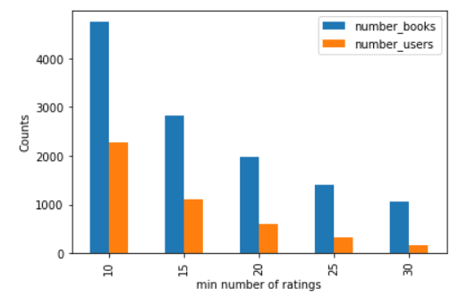
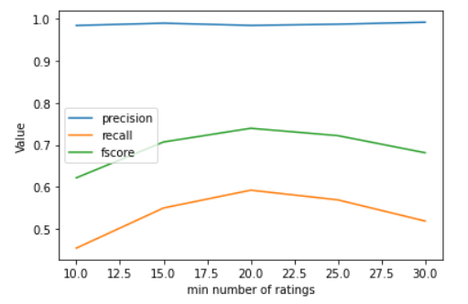
Individual recommendation: User-based CF
Tuning parameters: minimum number of ratings
Notes:
Which are the techniques (state-of-the-art, or innovative) that have been applied or developed in your project?
User-based Collaborative Filtering
Has Cold-start problem -> Evaluation only on users that meet requirements.
Content-Boosted Collaborative Filtering -> Explained Later in the presentation.
Turning Parameters on the minimum number of ratings
Higher rating requirements lead to lower book and user counts.
Sweet spot around a minimum of 20 ratings
Not enough ratings -> Lower Recall and FScore
Too many ratings -> Too few data, thus also lower recall and fscore

Slide 4
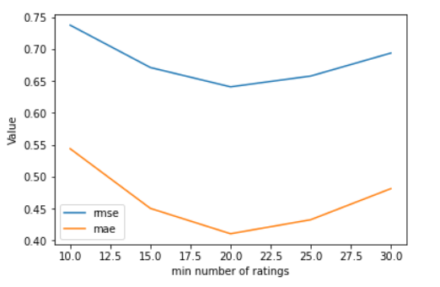
Individual recommendation: User-based CF
Tuning parameters: minimum number of ratings
Notes:
Which are the techniques (state-of-the-art, or innovative) that have been applied or developed in your project?
This is also shown in the RMSE / MAE.

Slide 5
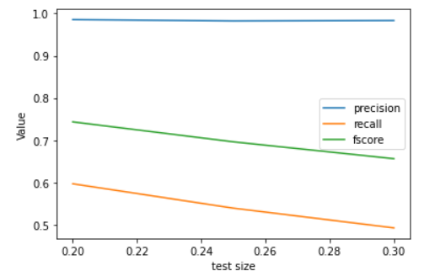
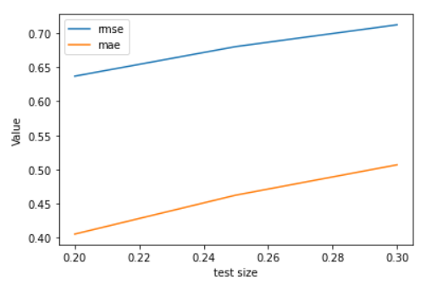
Individual recommendation: User-based CF
Tuning parameters: splitting
Notes:
Which are the techniques (state-of-the-art, or innovative) that have been applied or developed in your project?
Splitting the data into different train/test splits also impacts the accuracy, as there are so few actual samples.
A 80/20 split seemed to give us better results in combination with the time.

Slide 6
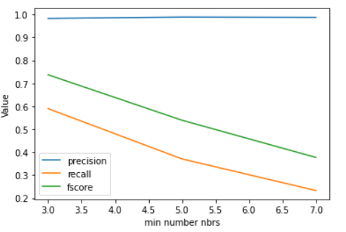
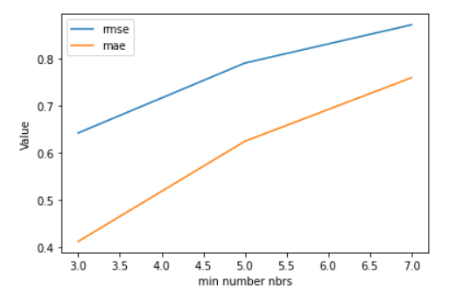
Individual recommendation: User-based CF
Tuning parameters: minimum number of neighbours
Notes:
Which are the techniques (state-of-the-art, or innovative) that have been applied or developed in your project?
Tuning the Minimum and Maximum Neighbors

Slide 7
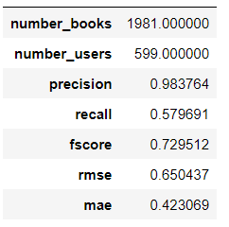
Individual recommendation: User-based CF
Tuning parameters
Optimal parameters
min number ratings | 20.00
test size | 0.20
min nbrs | 3.00
max nbrs | 11.00
Notes:
Which are the techniques (state-of-the-art, or innovative) that have been applied or developed in your project?

Slide 8
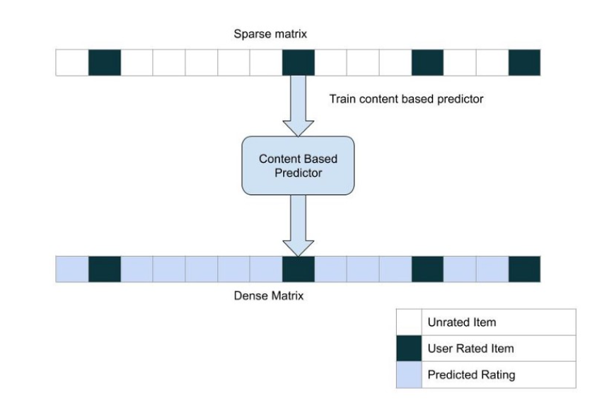
Individual recommendation: Content boosted CF
Content: Book Title
Rating Prediction for unseen/unrated books for user(s)
Notes:
Which are the techniques (state-of-the-art, or innovative) that have been applied or developed in your project?

Slide 9
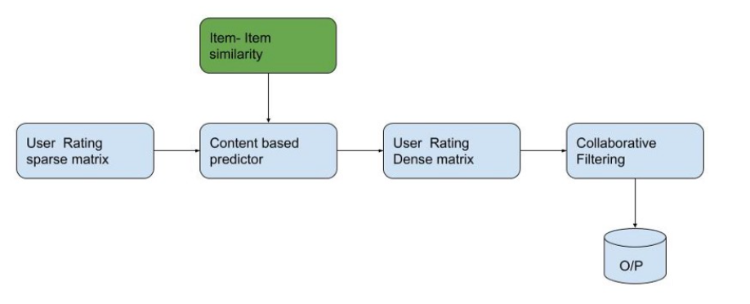
Individual recommendation: Content boosted CF
Notes:
Which are the techniques (state-of-the-art, or innovative) that have been applied or developed in your project?

Slide 10
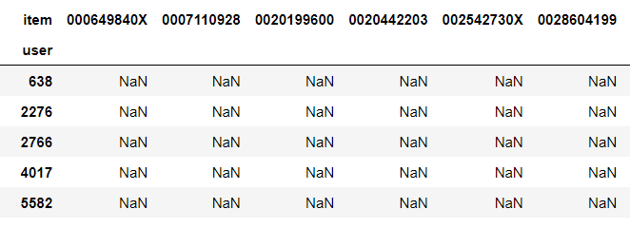
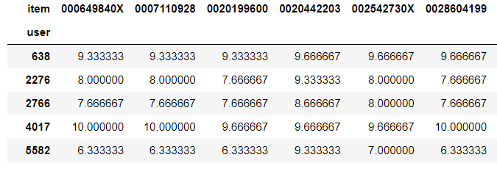
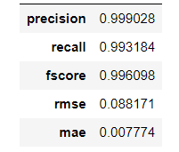
Individual recommendation: Content boosted CF
Notes:
Which are the techniques (state-of-the-art, or innovative) that have been applied or developed in your project?

Slide 11
Individual explanations
“Based on your previous ratings we found similar users that liked this book and we think you'd also like this book with a predicted rating of X “

Slide 12
Individual recommendation: Item-based CF
Item-based nearest-neighbor collaborative-filtering
Book Ratings
Looks for similar items based on the items users have already rated
Notes:
Which are the techniques (state-of-the-art, or innovative) that have been applied or developed in your project?

Slide 13
Individual explanations
Based on your previous ratings we found books that similar to books which you have already rated.
Do you want detailed description of your recommendation? (Y/N)
if Yes => “Also, the algorithm computed predicted scores to demonstrate how the book fits with your preferences.”
“ Above illustrated books and their predicted scores”

Slide 14
Individual evaluation
Item-based nearest-neighbor collaborative-filtering
Testing with different parameters:
minimum book ratings
minimum & maximum neighbours
test split size
89 test cases
Optimal parameters
Books | Users | min_book_ratings | min&max neighbours | test split size | RMSE | MAE
1492 | 28471 | 25 | [1, 12] | 20% | 0.621137 | 0.385811

Slide 15
Group recommender system - 1
Given set of books and users
Users have rated some of the books already
Calculate missing ratings for users using User-based CF
Building similarity matrix based on Pearson correlation
Based on similarity between users predict rating
Based on these new ratings give recommendation
Average
Least misery

Slide 16
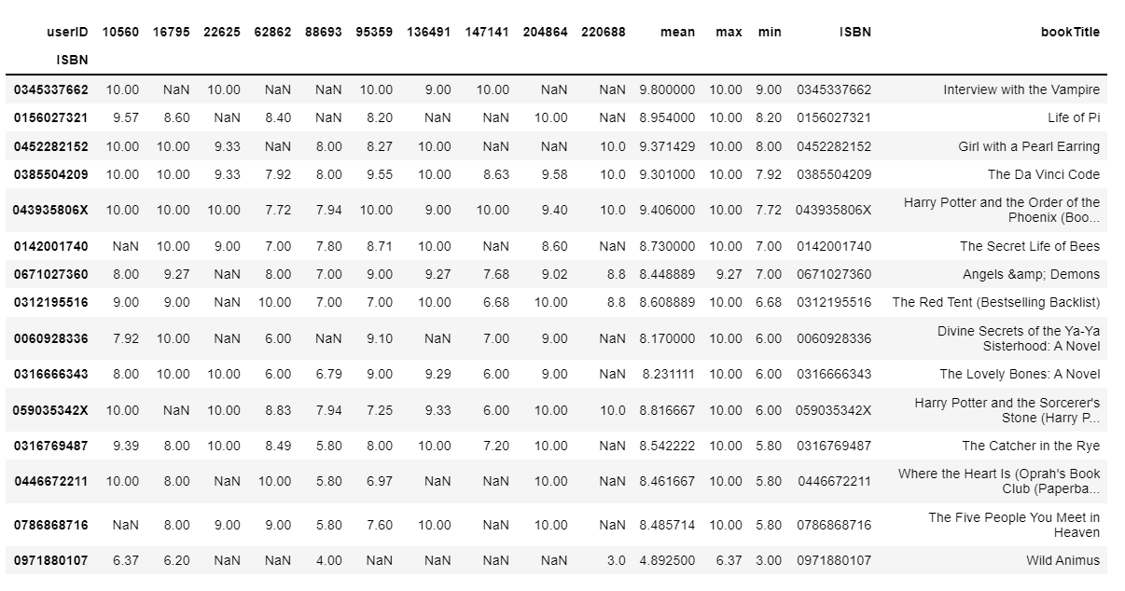
Explanation

Slide 17
Evaluation
Very constrained
Not enough groups can be made to evaluate
Users have not rated the exact same books
Only recommend books that some users have read
Improve by predicting ratings based on all users
Would be useful if users predict what they would rate a book

Slide 18
Group recommender system - 2
Item-based nearest-neighbor collaborative-filtering for groups
Book ratings
Matrix with similar unseen books with predicted values
3 types of Aggregation strategies:
Approval voting (Majority Based)
Average (Consensus Based)
Most pleasure (Borderline)

Slide 19
Group explanations
Detailed description depends on aggregation strategy*
Based on your previous ratings we found books that similar to books which you have already rated.
Do you want detailed description of your recommendation? (Y/N)
if Yes => “Also, the algorithm applied Approval Voting strategy to your prediction to choose books by predicted votes to unseen books ”
“ Above illustrated books and their predicted scores”

Slide 20
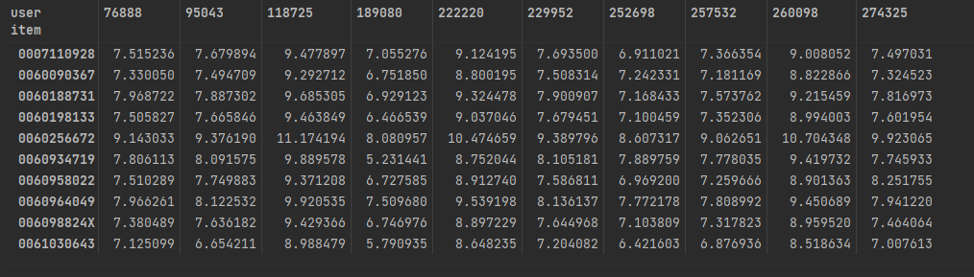
Evaluation
Maximum group size 12 people -> otherwise few books for the recommendation
Hard to evaluate with offline data
Future work -> perform experiment with real people to measure ranking quality (nDCG)

Slide 21
Thank you for listening!

